Slide 1
Program Name goes here
Link to github Repository:https://github.com/levinelson69/pizza_bot
Links to trello board / project management tools:https://trello.com/b/yOTwL0jY/pizza-bot
You MUST provide evidence showing how the problem has been decomposed, how the components have been developed and trialled, and of how they have been assembled and tested to create a final, working outcome.

Slide 2
Relevant Implications
Explain the relevant implications here. Please watch this video to learn how to do this.
Notes:
Explain the relevant implications here. Then as you work, develop your code, discuss how the implications are being met.

Slide 3
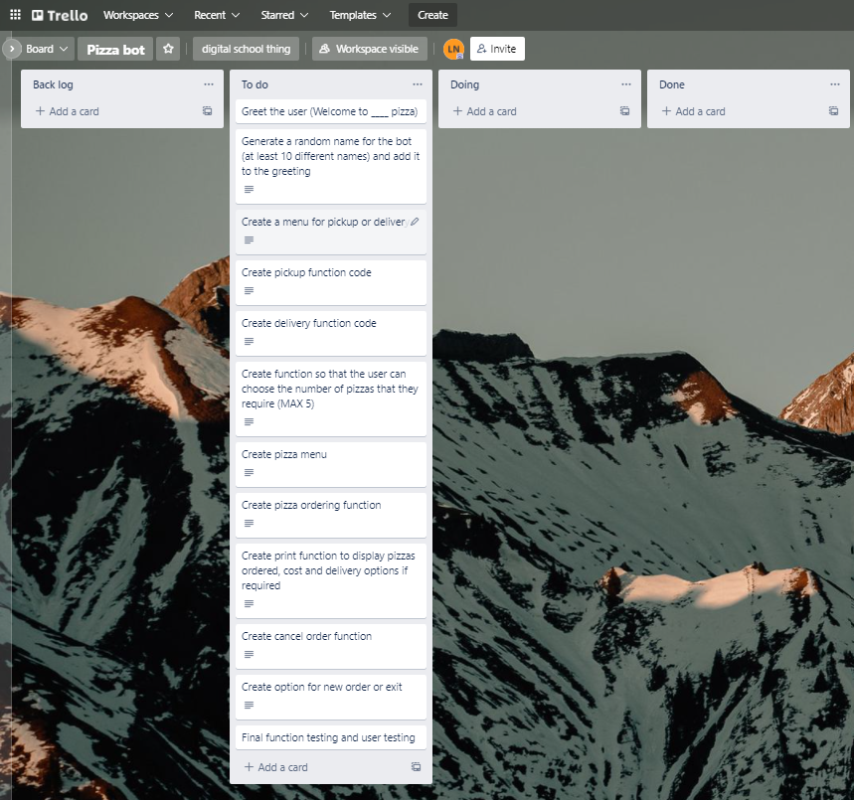
Decomposition
Notes:
Paste screenshots of your initial Trello board / task decomposition on this slide. If you have a long list, you might need to break it up into several columns. Delete this instruction when you are done.

Slide 4
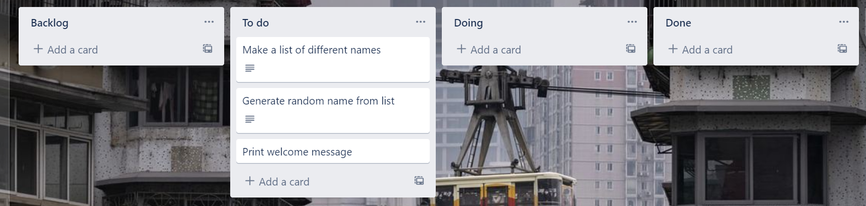
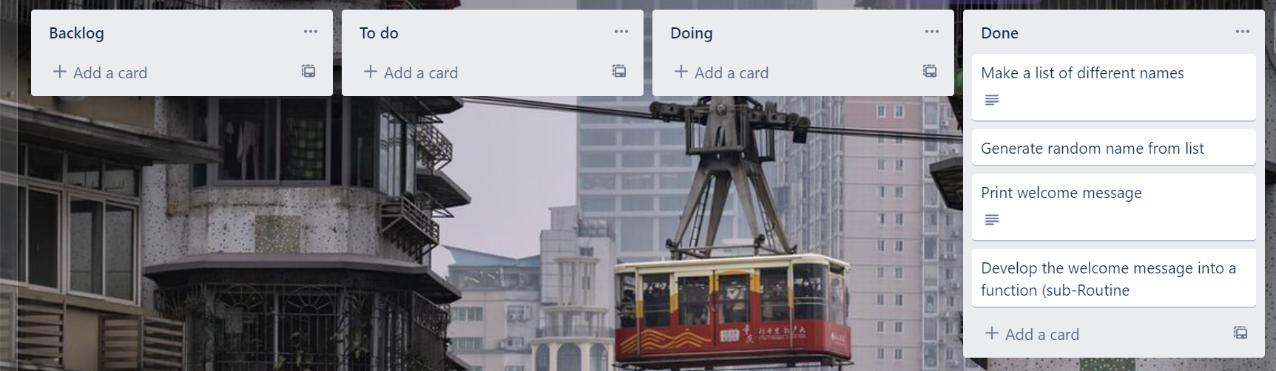
Component 1 (Trello screenshot)
Version 1
Version 2

Slide 5
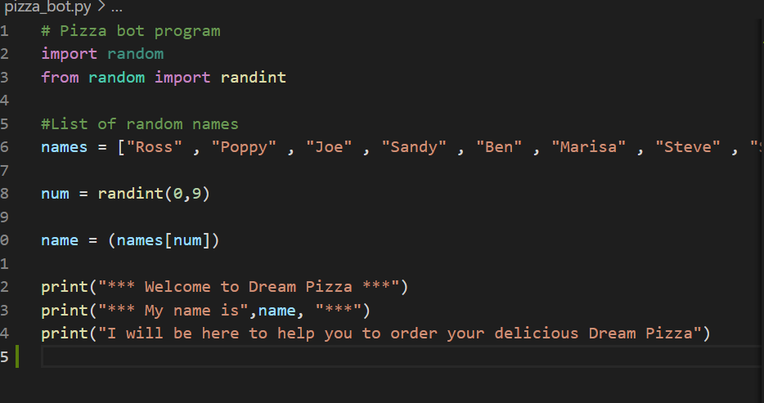
Component 1 - Test Plan (?and screenshot)
Test Case | Expected Values
Run Program | Print welcome message with random name from list of names – Runs correctly

Slide 6
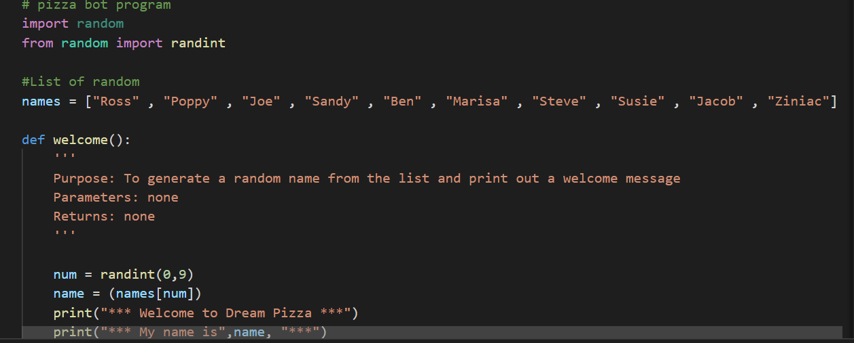
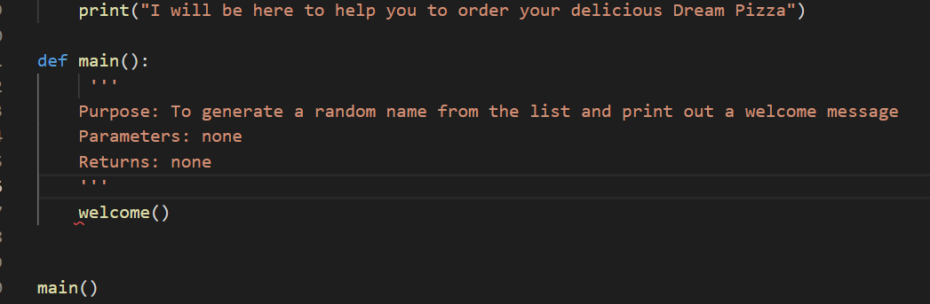
Component 1 Version 2- Test Plan (and screenshot)
Test Case | Expected Values
Run Program | Print welcome message with random name from list of names – Runs correctly

Slide 7
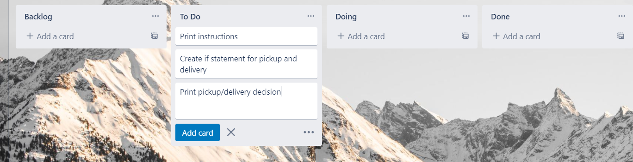
Component 2 (Trello screenshot)

Slide 8
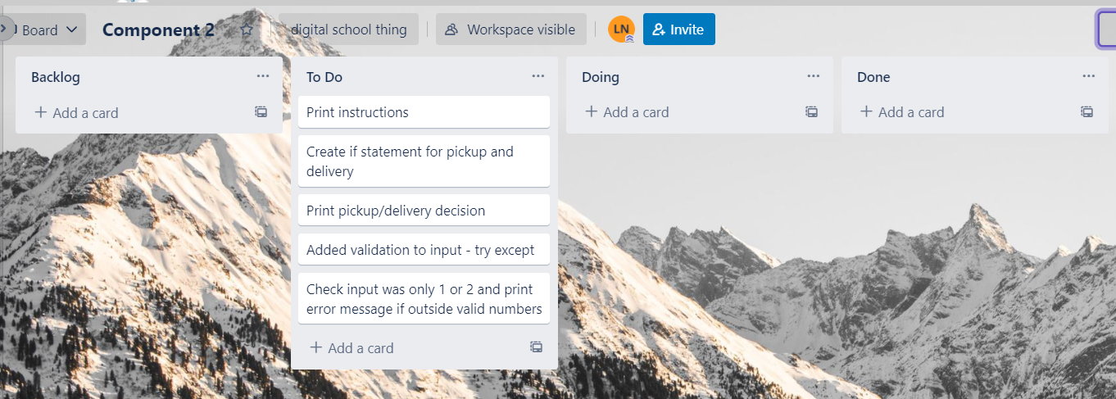
Component 2 Version 2(Trello screenshot)

Slide 9
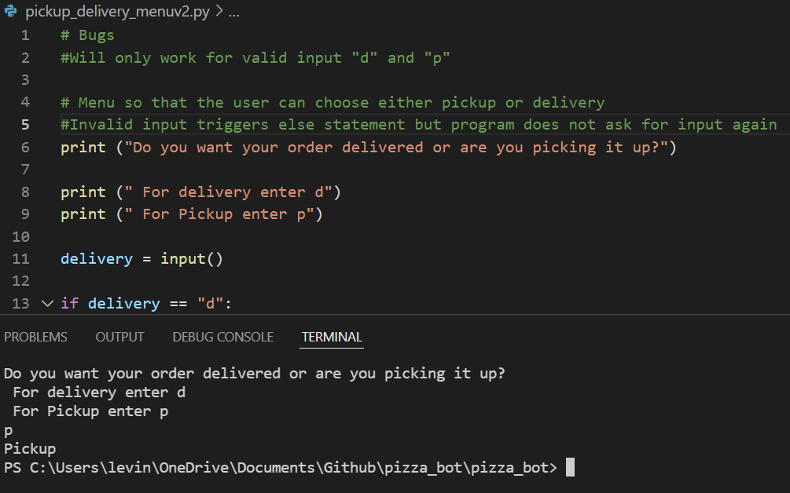
Component 2 Version 1- Test Plan (and screenshot)
Test Case | Expected Values
Run Program | Enter p program prints pickup Enter d program prints delivery Enter invalid program stops

Slide 10
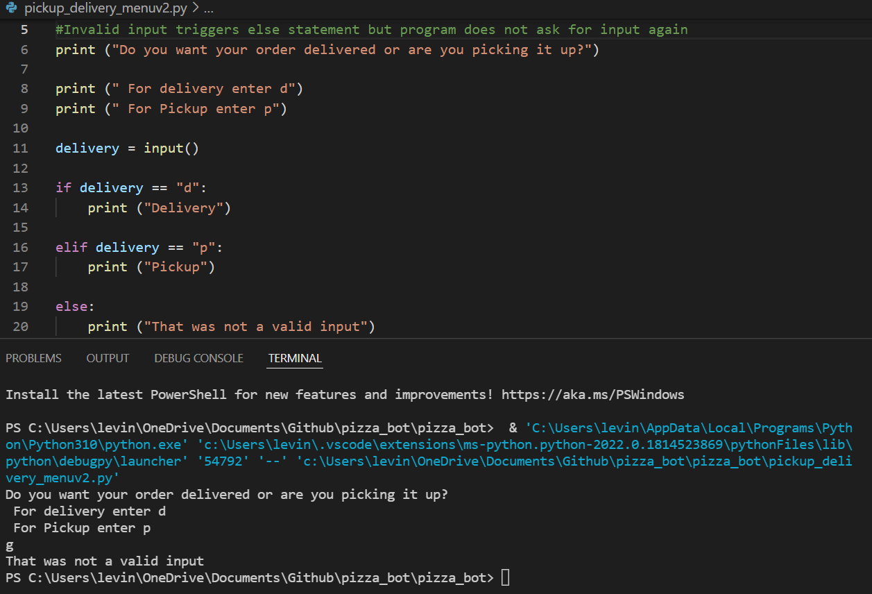
Component 2 Version 2- Test Plan (and screenshot)
Test Case | Expected Values
Run Program | Enter p program prints pickup Enter d program prints delivery Enter invalid prints error message

Slide 11
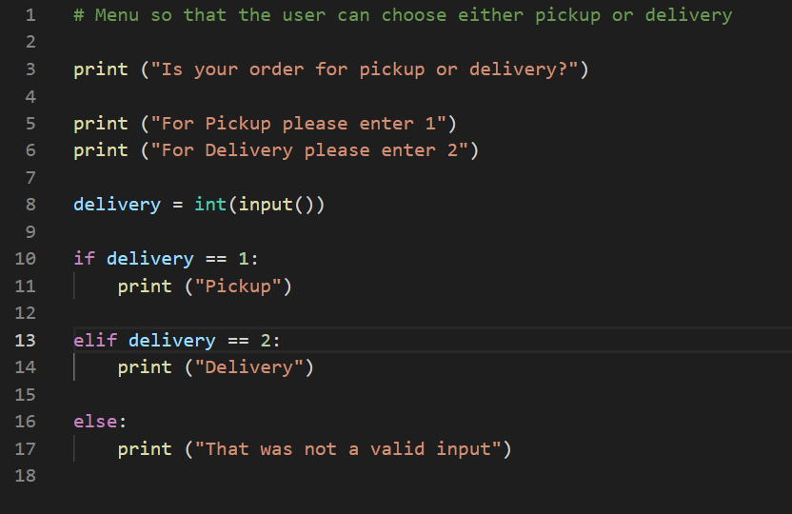
Component 2 Version 3- Test Plan (and screenshot)
Test Case | Expected Values
Run Program | Enter 1 program prints pickup Enter 2 program prints delivery Enter invalid program displays value error

Slide 12
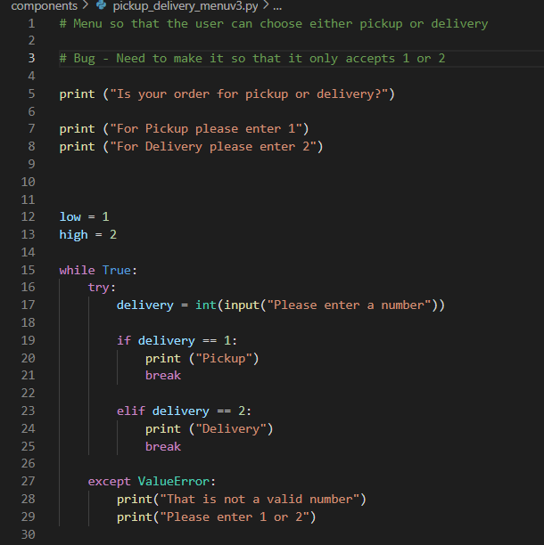
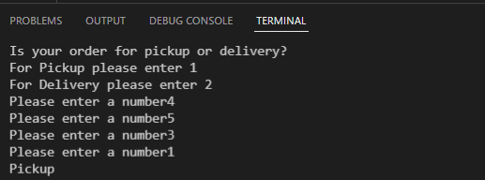
Component 2 Version 4- Test Plan (and screenshot)
Test Case | Expected Values
Run Program | Enter 1 program prints pickup Enter 2 program prints delivery Enter invalid prints error message Enter number other than 1 or 2 does not work

Slide 13
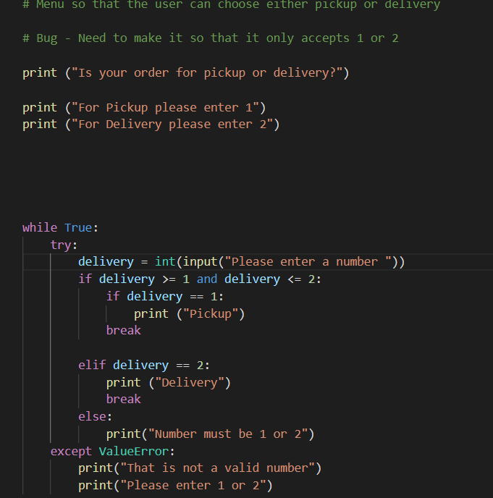
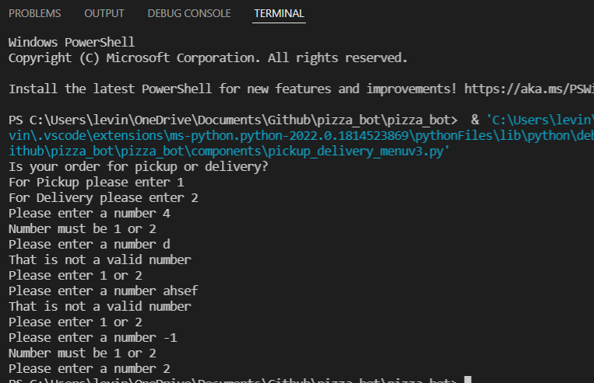
Component 2 Version 5- Test Plan (and screenshot)
Test Case | Expected Values
Run Program | Enter 1 program prints pickup Enter 2 program prints delivery Enter invalid entry - error message asks for input again Enter number other than 1 or 2 – error message asks for entry again

Slide 14
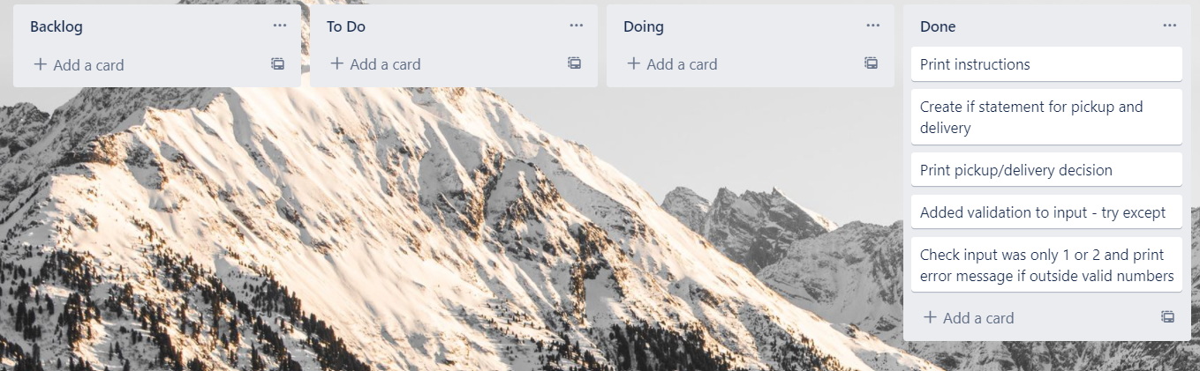
Component 2 Version 3(Trello screenshot)

Slide 15
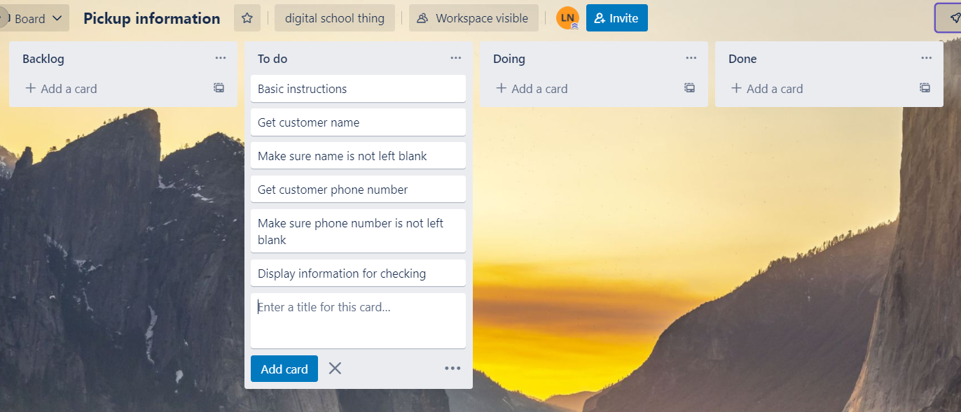
Component 3 Pick up info(Trello screenshot)

Slide 16
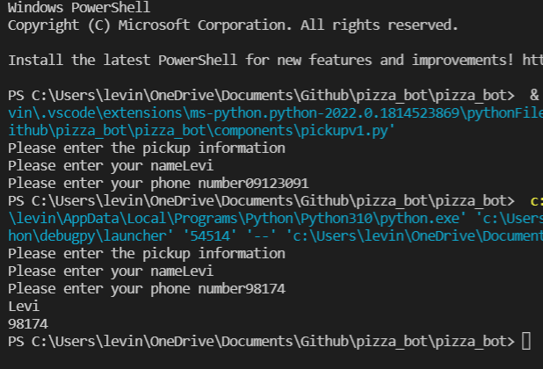
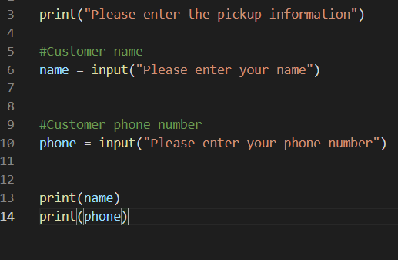
Component 3 Version 1 - Test Plan (?and screenshot)
Test Case | Expected Values
Input name Input phone number Left input blank | Printed name correctly Printed phone number correctly Accepted blank and printed blank input

Slide 17
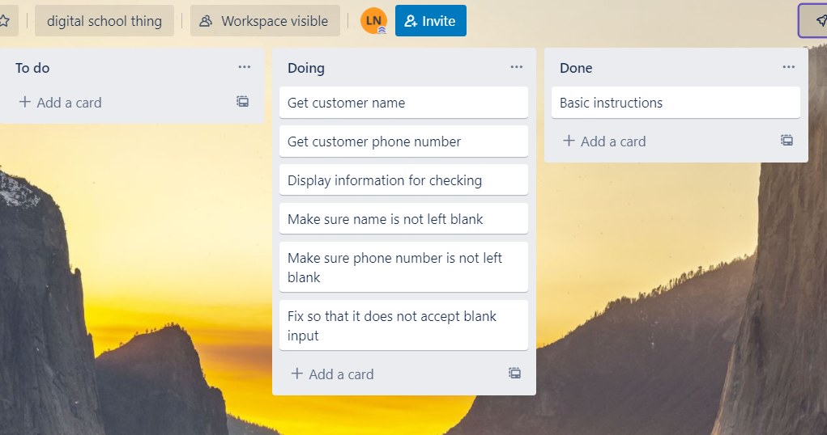
Component 3 Pick up info v2(Trello screenshot)

Slide 18
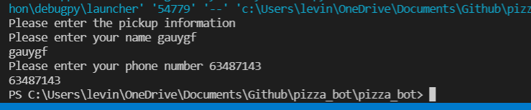
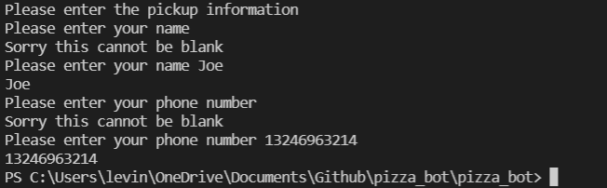
Component 3 Version 2 - Test Plan (?and screenshot)
Test Case | Expected Values
Input name Input phone number Left input blank | Printed name correctly Printed phone number correctly Prints “Sorry this cannot be blank” – goes back to input

Slide 19
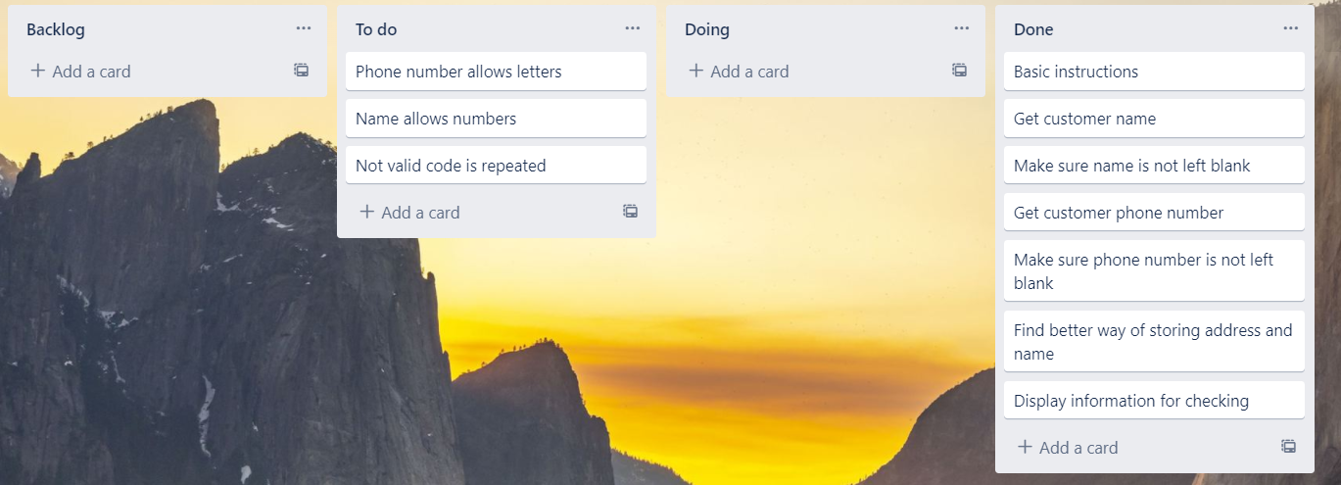
Component 3 Pick up info v3(Trello screenshot)

Slide 20
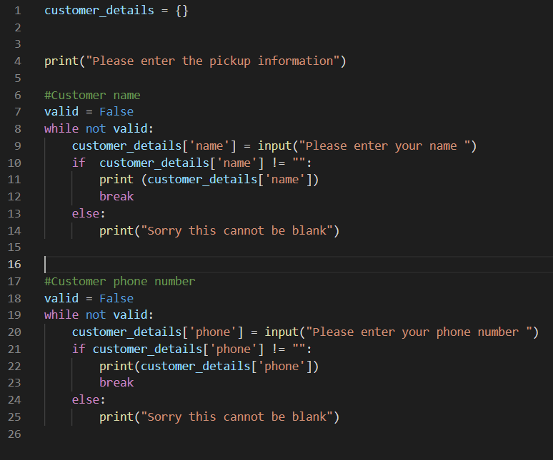
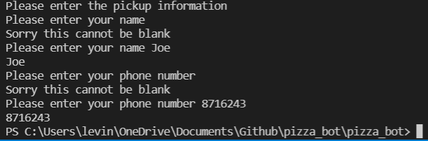
Component 3 Version 3 - Test Plan (?and screenshot)
Test Case | Expected Values
Input name Input phone number Left input blank | Printed name correctly Printed phone number correctly Prints “Sorry this cannot be blank” – goes back to input

Slide 21
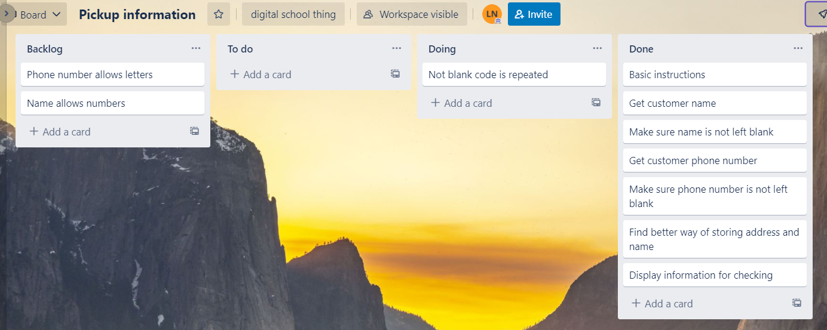
Component 3 Pick up info v4(Trello screenshot)

Slide 22
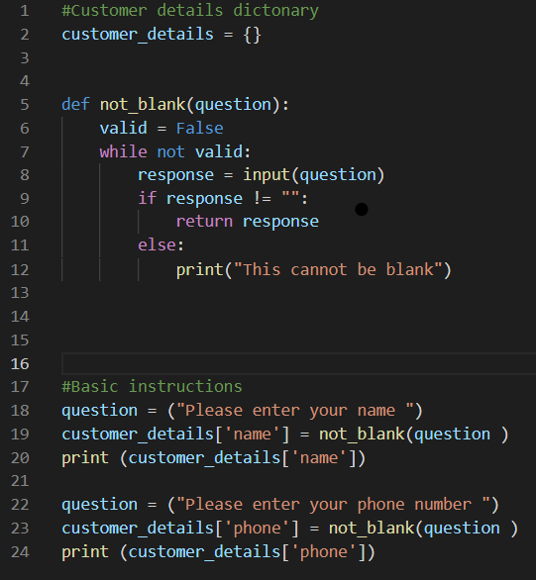
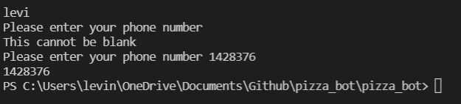
Component 3 Version 4 - Test Plan (?and screenshot)
Test Case | Expected Values
Input name Input phone number Left input blank | Printed name correctly Printed phone number correctly Prints “Sorry this cannot be blank” – goes back to input

Slide 23
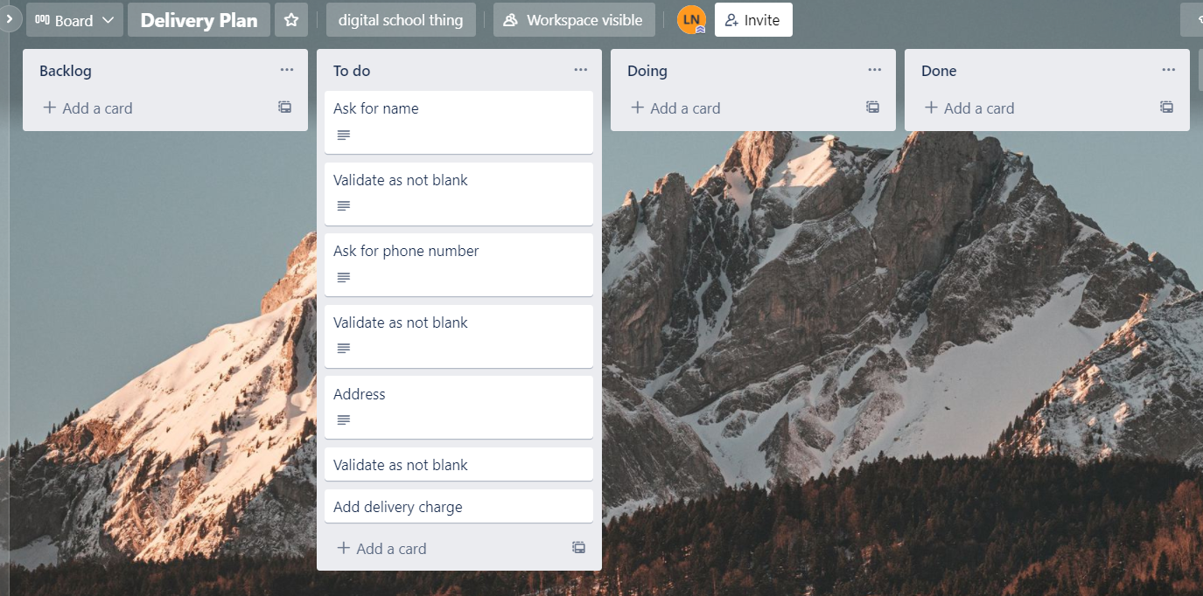
Component 4 Delivery info(Trello screenshot)

Slide 24
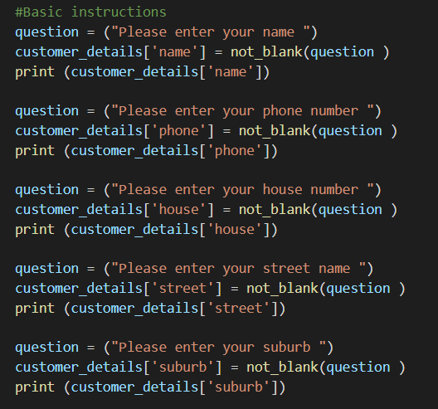
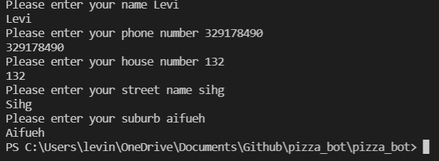
Component 4 Version 1 - Test Plan (?and screenshot)
Test Case | Expected Values
Input name Input phone number Input house number Street name Suburb name Left input blank | Printed name correctly Printed phone number correctly Accepted blank and printed blank input Printed street name Printed suburb name Asked for input again

Slide 25
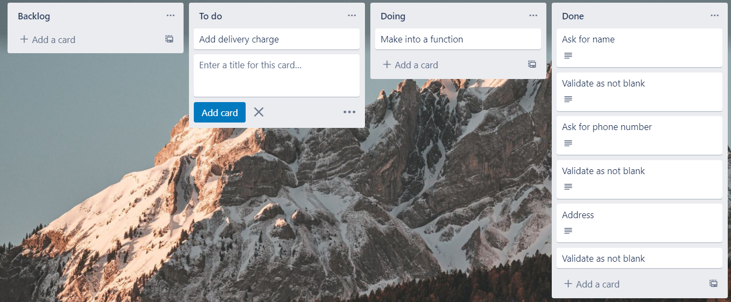
Component 4 Delivery info Version 2 (Trello screenshot)

Slide 26
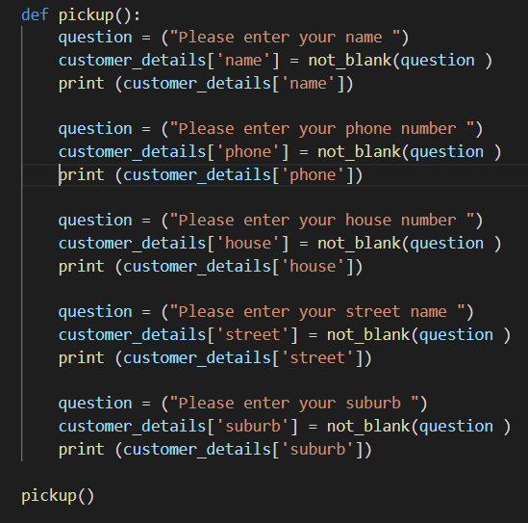
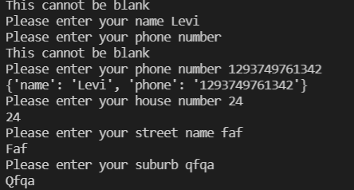
Component 4 Version 2 - Test Plan (?and screenshot)
Test Case | Expected Values
Input name Input phone number Input house number Street name Suburb name Left input blank | Printed name correctly Printed phone number correctly Printed house number Printed street name Printed suburb name Asked for input again

Slide 27
Component 4 Delivery info Version 3 (Trello screenshot)

Slide 28
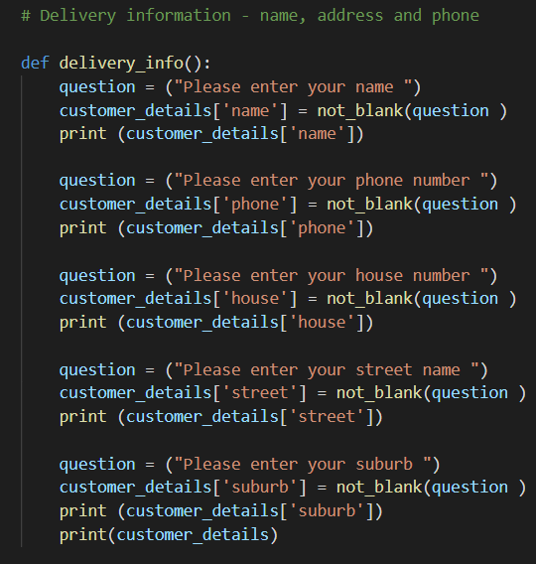
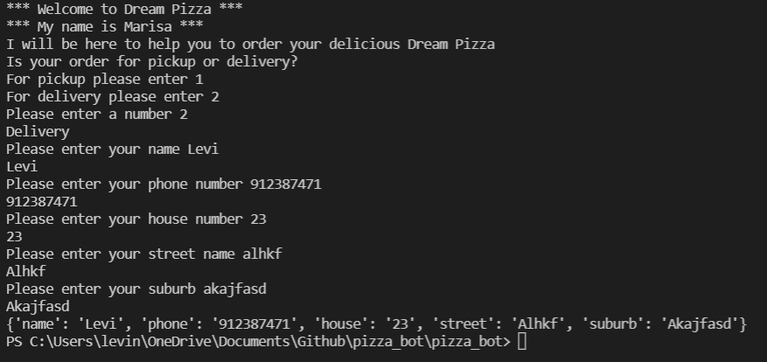
Component 4 Version 3 - Test Plan (?and screenshot)
Test Case | Expected Values
Input name Input phone number Input house number Street name Suburb name Left input blank | Printed name correctly Printed phone number correctly Printed house number Printed street name Printed suburb name Asked for input again

Slide 29
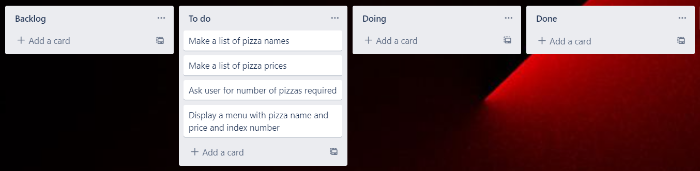
Component 5 Pizza menu Version 1 (Trello screenshot)

Slide 30
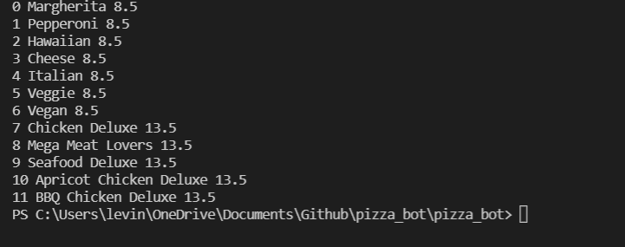
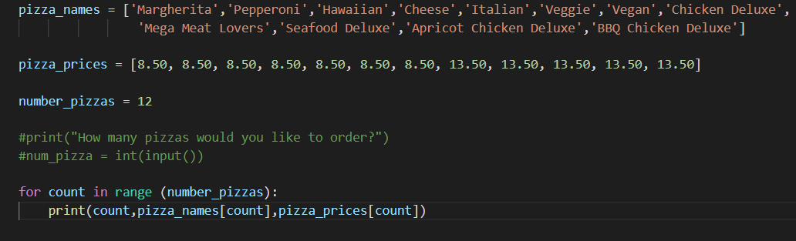
Component 5 Version 1 - Test Plan (?and screenshot)
Test Case | Expected Values
Run file | Printed a list with index number, pizzas and prices

Slide 31
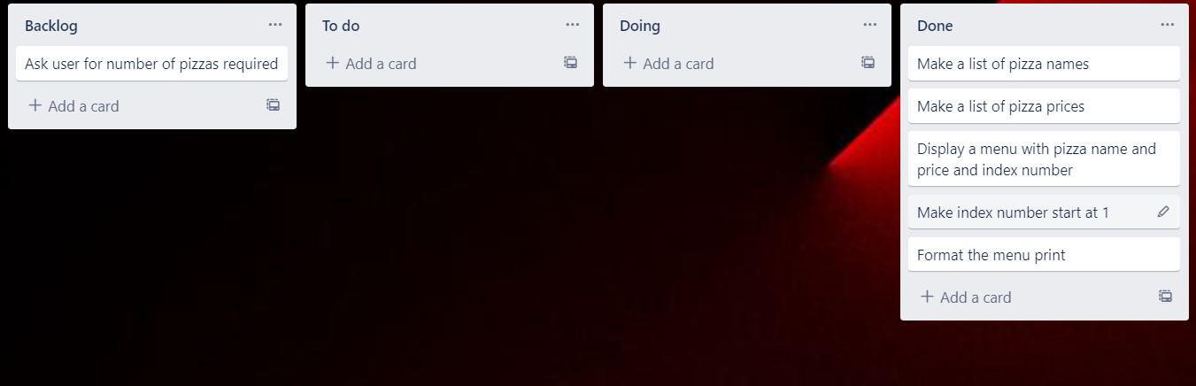
Component 5 Pizza menu Version 2 (Trello screenshot)

Slide 32
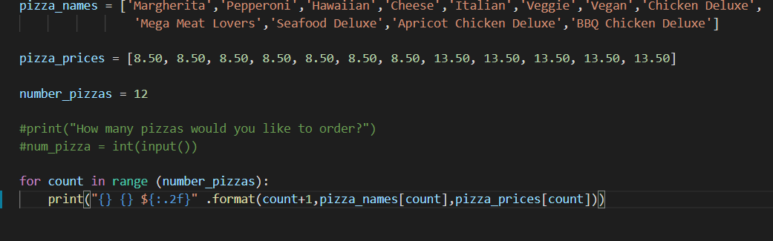
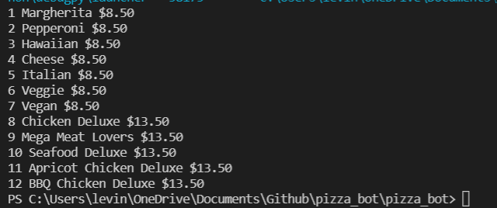
Component 5 Version 2 - Test Plan (?and screenshot)
Test Case | Expected Values
Run file | Printed a list with index number, pizzas and prices With price formatted to 2 decimal places and dollar sign. Menu starts at 1.

Slide 33
Component 5 Pizza menu Version 2 (Trello screenshot)

Slide 34
Component 5 Version 2 - Test Plan (?and screenshot)
Test Case | Expected Values
Run file | Printed a list with index number, pizzas and prices With price formatted to 2 decimal places and dollar sign. Menu starts at 1.

Slide 35
Version Control Evidence
Your version control evidence should go here. This could be in the form of annotated screenshots which show you you managed this process or you could make a brief screencast explaining how you implemented version control.
Notes:
Your version control evidence should go here. This could be in the form of annotated screenshots which show you you managed this process or you could make a brief screencast explaining how you implemented version control.

Slide 36
Discusses how the information from planning, testing and trialling of components assisted in the development of a high-quality outcome
Notes:
Discusses how the information from planning, testing and trialling of components assisted in the development of a high-quality outcome

